Slide 1

Feasibility Analysis of Solar Power Plant in Connecticut
Team :
Arun Mantra Kalathil
Mazhar Kodithodika
Neha Telagubanajigara Jagannath
Partha Ganrai

Slide 2
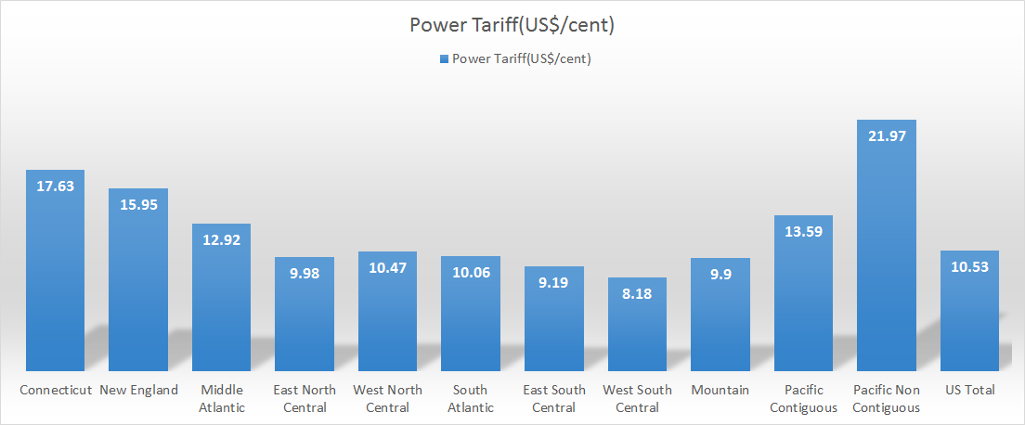
Background:
Existing Power Tariff Analysis
Average Electricity Tariff across Territories of the United States
1

Slide 3

Will it be feasible in Connecticut?
2

Slide 4
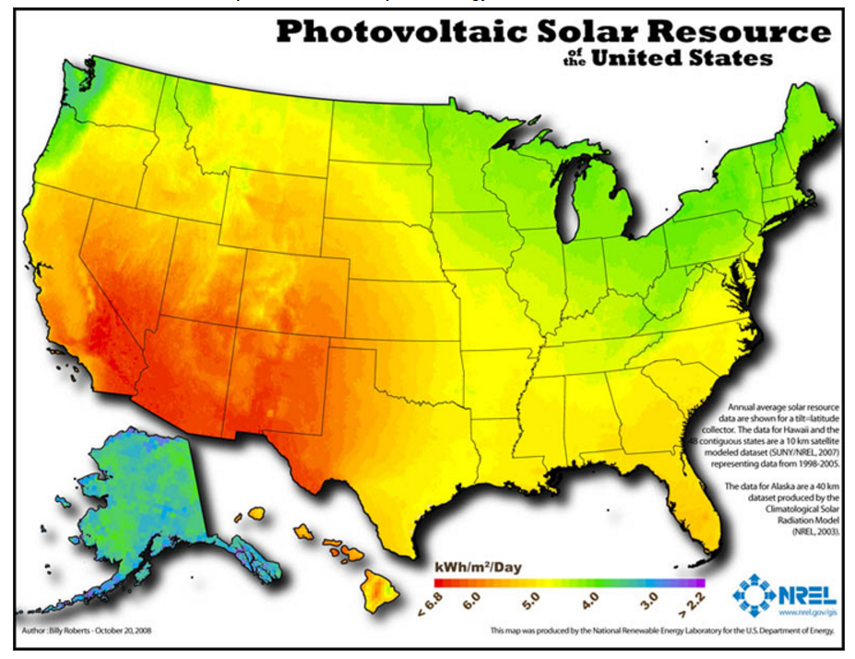
How do we Harness Solar Energy?
3

Slide 5
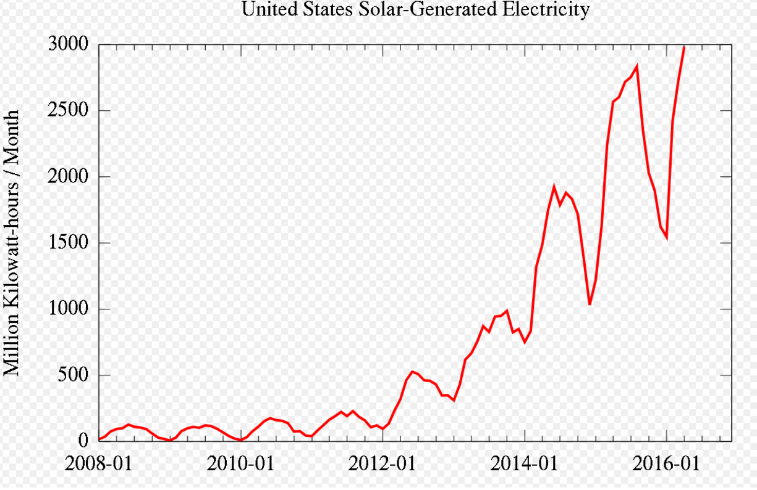
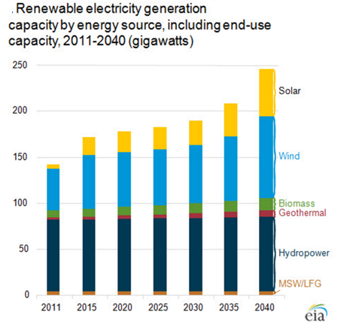
Growth Trend of Electricity generated using Solar Technology in United States
4

Slide 6
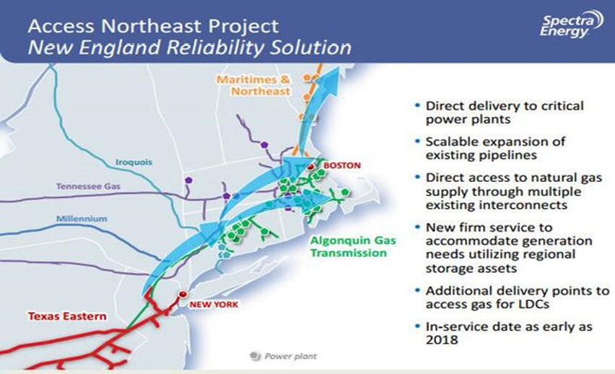
Existing Market Competition
5

Slide 7
Marketing: Who will buy the power?
Power Purchase Agreement(PPA)
A solar power purchase agreement (PPA) is a financial agreement where a developer arranges for the design, permitting, financing and installation of a solar energy system on a customer’s property at little to no cost.
The developer sells the power generated to the host customer at a fixed rate that is typically lower than the local utility’s retail rate.
Approximately 90% of commercial photovoltaics installed in the United States were installed using a power purchase agreement.
Hence, we assume our project is to be developed based on a previously made PPA . i.e. total production of the power plant has full demand since the tariff is less than the existing tariff in Connecticut.
6

Slide 8
Factors Considered and Decisions
Parameters
Tariff
Annual Tariff Increment rate
O&M Cost
Land rent
Land area required
Tax Rate
Power Plant Technical Parameters
Specific Productivity
Annual decrease in productivity
EPCC Cost of PV Plant /Capital Investment
Financial Parameters
Loan Amount
Loan Interest Rate
Debt Term
Currency Inflation Rate
Decisions
Power Plant Capacity
Power Plant Lifetime
7

Slide 9
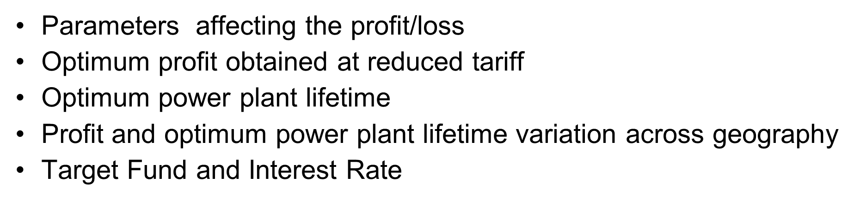
Objectives
8

Slide 10
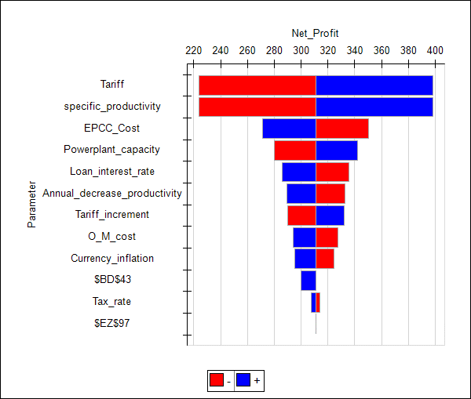
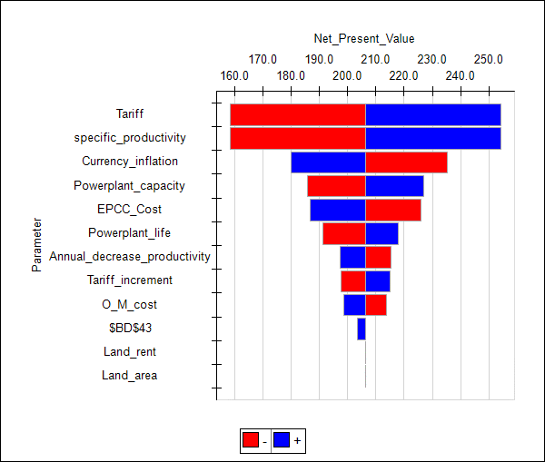
Parameters affecting the profit/loss
9

Slide 11
Scenario Analysis
10

Slide 12
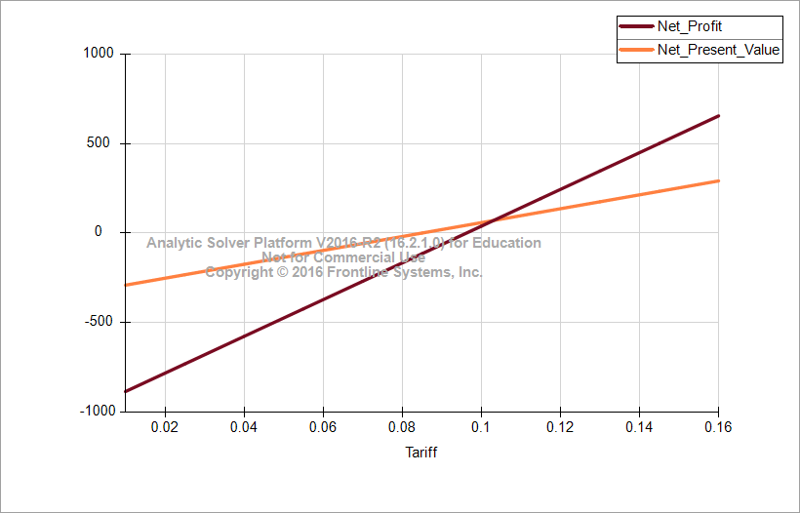
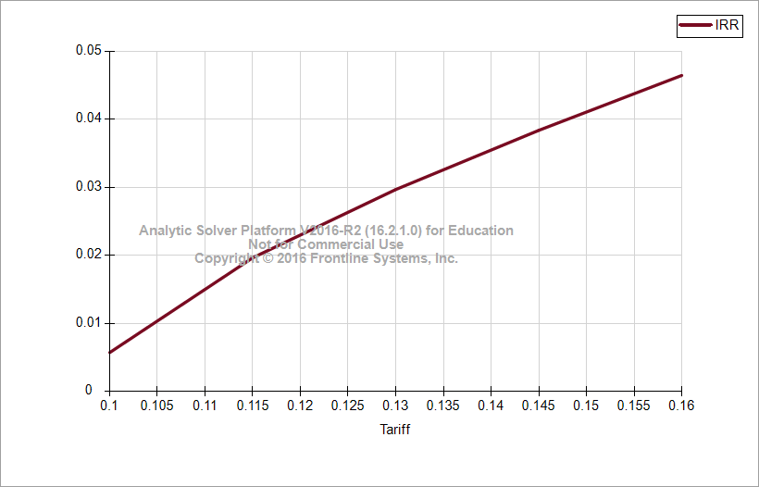
Net Profit and NPV Variation with Tariff
IRR Variation with Tariff
11

Slide 13
Net Profit Marginal Value Variation with Specific Productivity
Net Profit Marginal Value Variation with Tariff
12

Slide 14
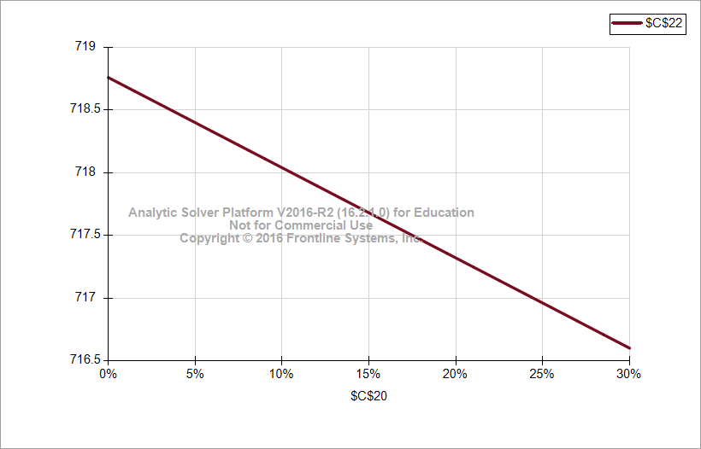
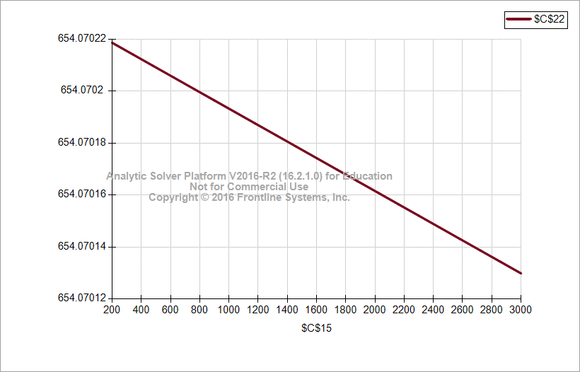
Sensitivity of Tax on Net Profit(mn$/percentage increase in tax)
Sensitivity of Land rent on Net Profit
13

Slide 15
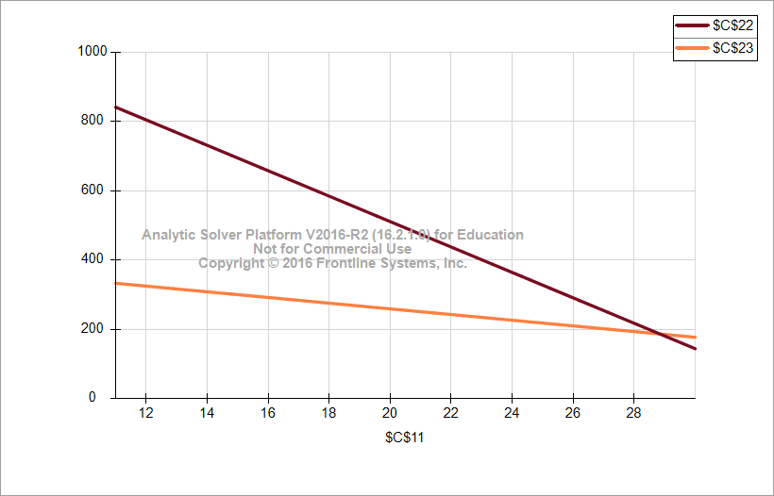
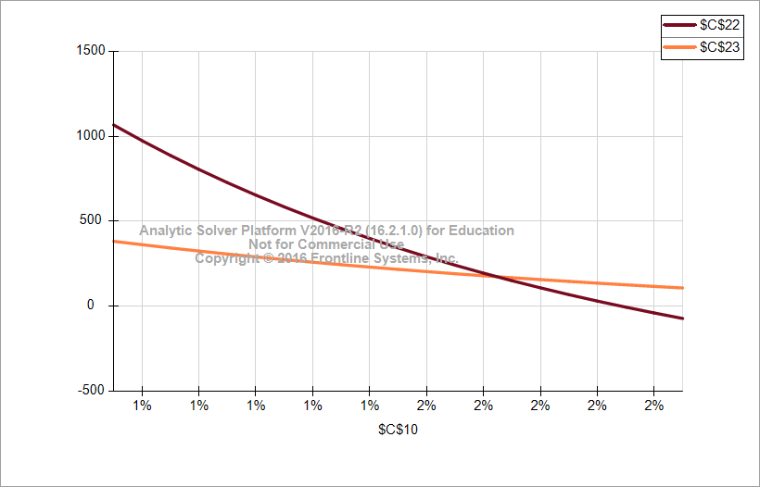
Variation of Net Profit and Net Present Value with O&M Cost($/KW/year)
Variation of Net Profit and Net Present Value with Annual Decrease in Productivity
14

Slide 16
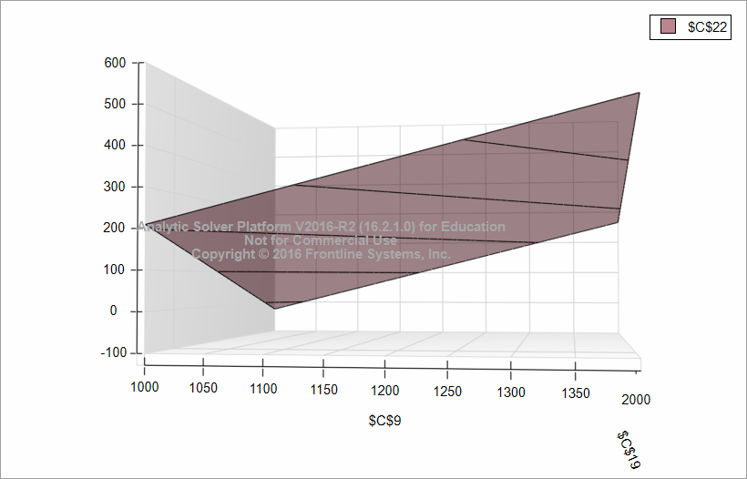
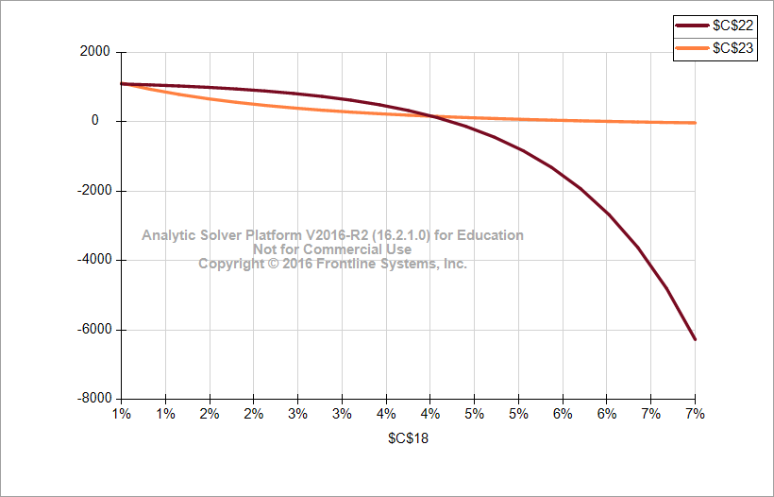
Variation of Net Profit wrt Specific Productivity and EPCC Cost
Variation of Net Profit and Net Present Value with Inflation
15

Slide 17
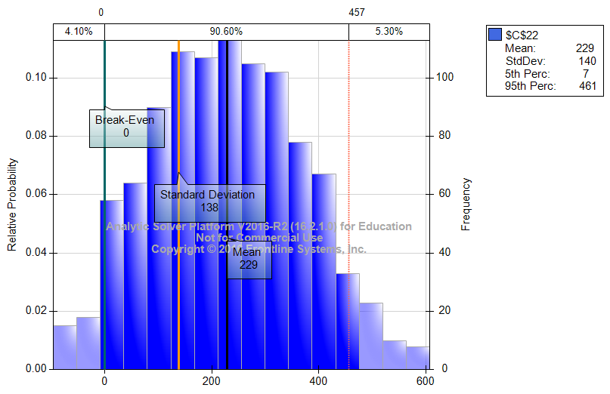
Probability of incurring Loss
16

Slide 18
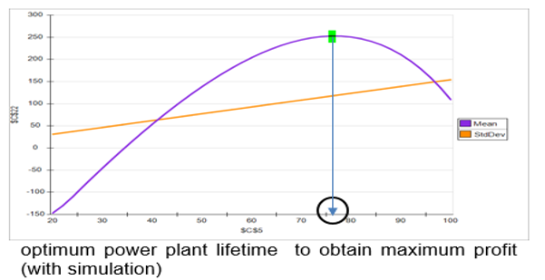
Optimum Lifetime of Power Plant Analysis
17

Slide 19
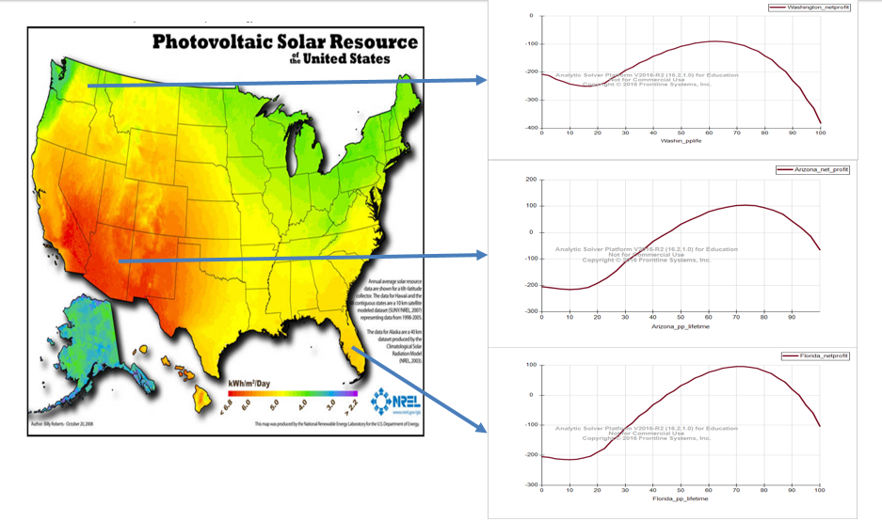
Profit and optimum power plant lifetime variation across geography
18

Slide 20
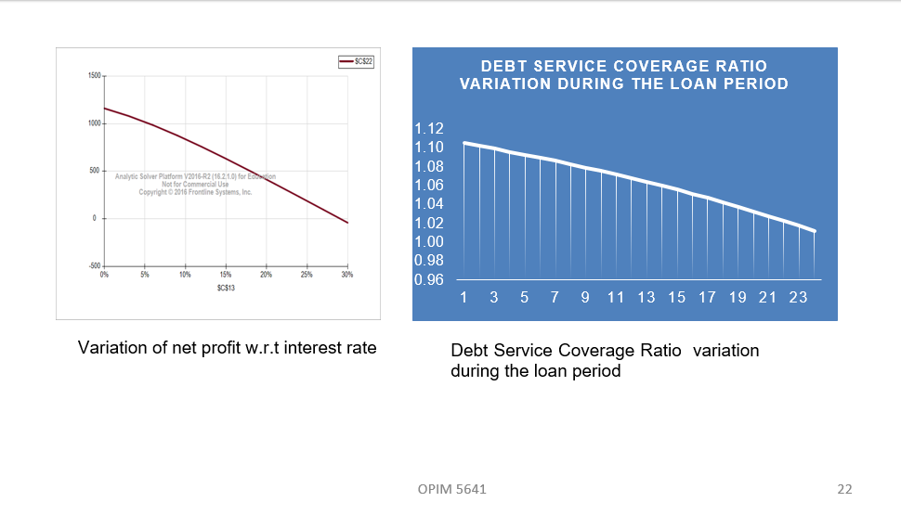
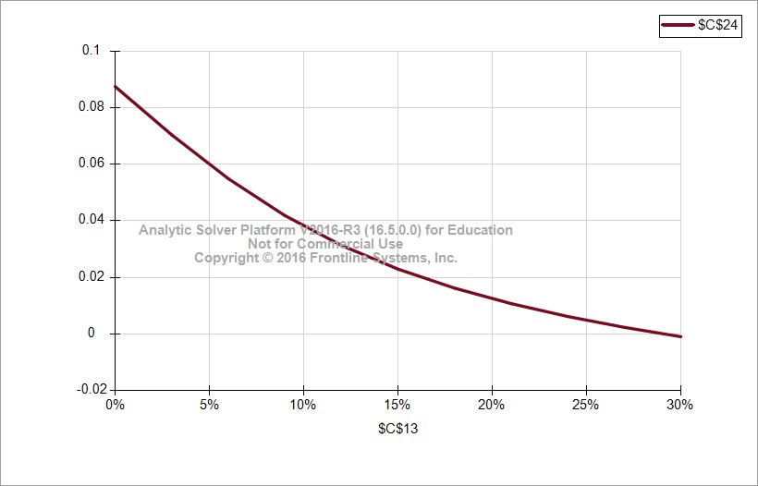
Target Fund and Interest Rate
Variation of IRR w.r.t interest rate
19

Slide 21

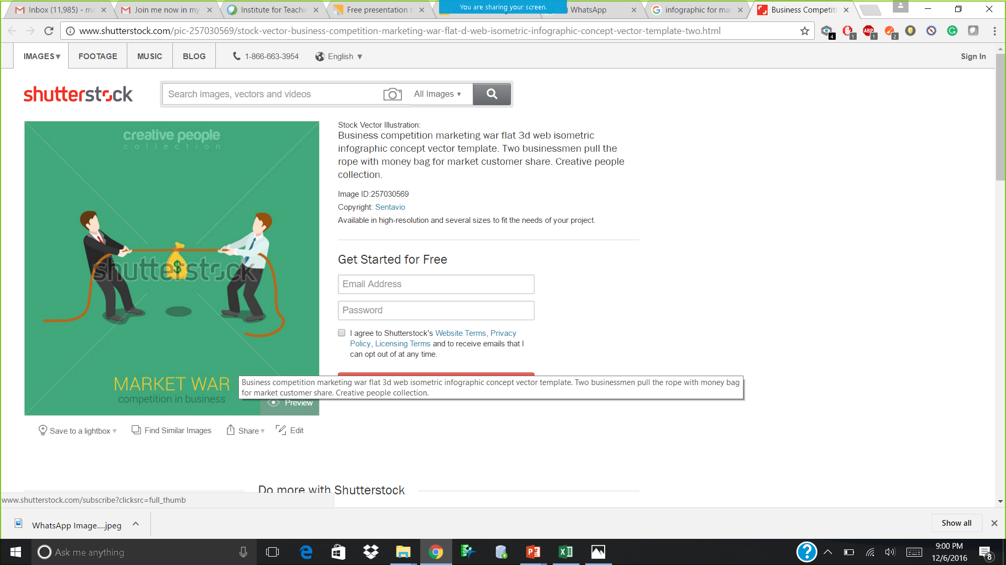
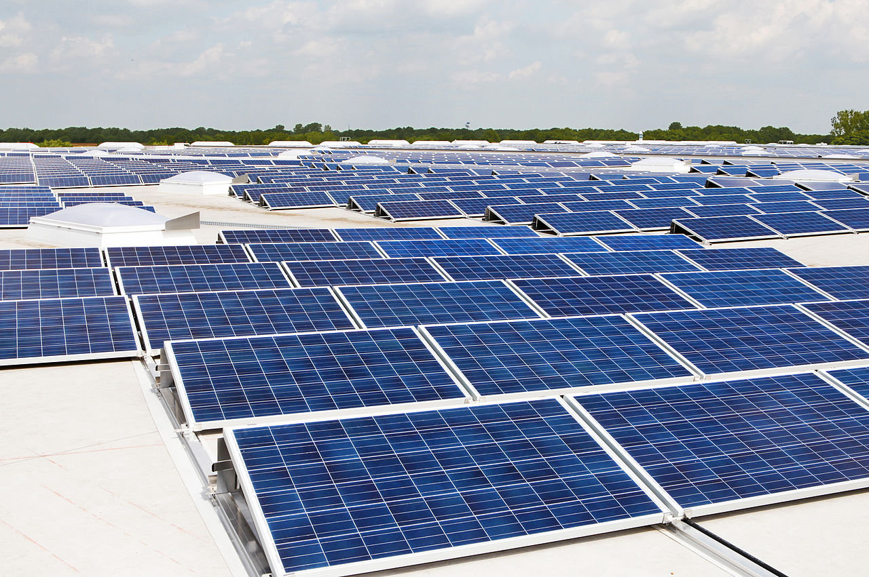
Recommendations
01
The project is feasible and yields a profit comparable to other financial investment tools like shares, bonds
02
Market competition from the ACESS NORTH EAST project should be considered since the current profit of the solar power plant is a 6% margin only
03
Ongoing Research in Solar Photovoltaic Technology will reduce the initial investment cost and increase the efficiency of the panels. If the efficiency were to increase by 1 unit then the anticipated net profit will increase by a million
04
The feasability of the power plant across geography is more influenced by the tariff as compared to the efficiency of the solar panels. Hence, the tariff factor is to be targeted in these regions
20

Slide 22
References
http://inflationdata.com/Inflation/Inflation_Rate/Long_Term_Inflation.asp
http://www.nrel.gov/
https://www.eia.gov/
21

Slide 23

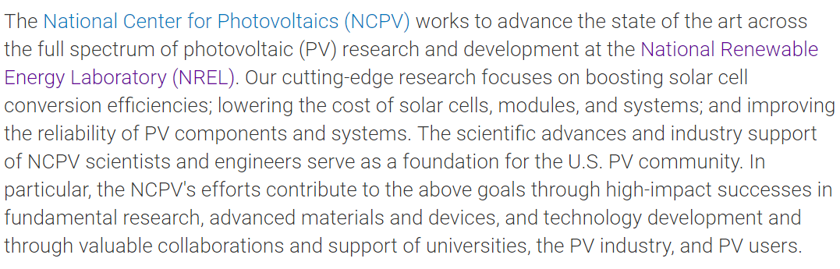
Ongoing Research – Possible Advance in Technology

Slide 24

THANKS!
Any questions?

